Slide 1
Unit 4
INTRODUCTION TO UN-SUPERVISED LEARNING AND DIMENSIONALITY REDUCTION

Slide 2
Clustering
The process of grouping a set of physical or abstract objects into classes of similar objects is called clustering. It is an unsupervised learning technique.
A cluster is a collection of data objects that are similar to one another within the same cluster and are dissimilar to the objects in other clusters.
Clustering can also be used for outlier detection, where outliers may be more interesting than common cases.
Applications of outlier detection include the detection of credit card fraud and the monitoring of criminal activities in electronic commerce.
For example, exceptional cases in credit card transactions, such as very expensive and frequent purchases, may be of interest as possible fraudulent activity.

Slide 3
Similarity and Dissimilarity
Distance measures are used in order to find similarity or dissimilarity between data objects.
The most popular distance measure is Euclidean distance, which is defined as:
where,
Another well-known metric is Manhattan (or city block) distance, defined as

Slide 4
Minkowski distance is a generalization of both Euclidean distance and Manhattan distance. It is defined as
Where p is a positive integer, such a distance is also called L_{p} norm, in some literature. It represents the Manhattan distance when p = 1 (i.e., L₁ norm) and Euclidean distance when p = 2 (i.e., L₂ norm).

Slide 5
Categories of Clustering Algorithms
Many clustering algorithms exist in the literature. In general, the major clustering methods can be classified into the following categories.
Partitioning Methods
Given a database of n objects or data tuples, a partitioning method constructs k partitions of the data, where each partition represents a cluster and k <n.
Given k, the number of partitions to construct, a partitioning method creates an initial partitioning. It then uses an iterative relocation technique that attempts to improve the partitioning by moving objects from one group to another.

Slide 6
Categories of Clustering Algorithms
Hierarchical Methods
A hierarchical method creates a hierarchical decomposition of the given set of data objects. A hierarchical method can be classified as being either agglomerative or divisive.
The agglomerative approach follows the bottom-up approach. It starts with each object forming a separate group. It successively merges the objects or groups that are close to one another, until a termination condition holds.
The divisive approach follows the top-down approach. It starts with all of the objects in the same cluster. In each successive iteration, a cluster is split up into smaller clusters, until a termination condition holds.

Slide 7
Categories of Clustering Algorithms
Density-based Methods
Most partitioning methods cluster objects based on the distance between objects. Such methods can find only spherical-shaped clusters and encounter difficulty at discovering clusters of arbitrary shapes.
Other clustering methods have been developed based on the notion of density. Their general idea is to continue growing the given cluster as long as the density (number of objects or data points) in the neighborhood exceeds some threshold.
Model-based Methods
Model-based methods hypothesize a model for each of the clusters and find the best fit of the data to the given model.
EM is an algorithm that performs expectation-maximization analysis based on statistical modeling.

Slide 8
K-Means Algorithm
K-means is one of the simplest partitioning based clustering algorithm. The procedure follows a simple and easy way to classify a given data set into a certain number of clusters (assume k clusters) fixed Apriori.
The main idea is to define k centers, one for each cluster. These centers should be selected cleverly because of different location causes different result. So, the better choice is to place them as much as possible far away from each other.

Slide 9
K-Means Algorithm
Example: Divide the data points {(2,10), ((2,5), (8,4), (5,8), (7,5), (6,4)} into two clusters.
Solution
Let p1=(2,10) p2=(2,5) p3=(8,4) p4=(5,8) p5=(7,5) p6=(6,4)
Initial step
Choose Cluster centers randomly
Let μ₁ =(2,5) and μ₂ =(6,4) are two initial cluster centers.

Slide 10
K-Means Algorithm
Iteration 2: New Cluster centers: μ₁ =(2,7.5) μ₂ =(6.5,5.25)
d(μ₁,p₁)=2.5 d(μ₂,p₁)=6.54
d(μ₁,p₂)=2.5 d(μ₂,p₂)=4.51
d(μ₁,p₃)=6.95 d(μ₂,p₃)=1.95
d(μ₁,p₄)=3.04 d(μ₂,p₄)=3.13
d(μ₁,p₅)=4.59 d(μ₂,p₅)= 0.56
d(μ₁,p₆)= 5.32 d(μ₂,p₆)=1.35
Thus, Cluster1={p1,p2,p4} cluster2={p3,p5,p6}

Slide 11
Iteration 3: New Cluster centers: μ₁ = (3,7.67) μ₂ ==(7,4.33)
d(μ₁,p₁)=2.54 d(μ₂,p₁)=7.56
d(μ₁,p₂)=2.85 d(μ₂,p₂)=5.04
d(μ₁,p₃)=6.2 d(μ₂,p₃)=1.05
d(μ₁,p₄)=2.03 d(μ₂,p₄)=4.18
d(μ₁,p₅)=4.81 d(μ₂,p₅)= 0.67
d(μ₁,p₆)= 4.74 d(μ₂,p₆)=1.05
Thus, Cluster1={p1,p2,p4} cluster2={p3,p5,p6}

Slide 12
Since, No data points are re-assigned
Final clusters are: Cluster1={p1,p2,p4} cluster2={p3,p5,p6}

Slide 13
Hierarchical clustering
Hierarchical clustering is another unsupervised machine learning algorithm, which is used to group the unlabeled datasets into a cluster and also known as hierarchical cluster analysis or HCA.
In this algorithm, we develop the hierarchy of clusters in the form of a tree, and this tree-shaped structure is known as the dendrogram.
The hierarchical clustering produces clusters in which the clusters at each level of the hierarchy are created by merging clusters at the next lower level. At the lowest level, each cluster contains a single observation. At the highest level there is only one cluster containing all of the data.
The decision regarding whether two clusters are to be merged or not is taken based on the measure of dissimilarity between the clusters. The distance between two clusters is usually taken as the measure of dissimilarity between the clusters.
Sometimes the results of K-means clustering and hierarchical clustering may look similar, but they both differ depending on how they work. As there is no requirement to predetermine the number of clusters as we did in the K-Means algorithm.

Slide 14
Dendrograms
Hierarchical clustering can be represented by a rooted binary tree. The nodes of the trees represent groups or clusters. The root node represents the entire data set. The terminal nodes each represent one of the individual observations(singleton clusters).
A dendrogram is a tree diagram used to illustrate the arrangement of the clusters produced by hierarchical clustering. The dendrogram may be drawn with the root node at the top and the branches growing vertically downwards. It may also be drawn with the root node at the left and the branches growing horizontally rightwards. In some contexts, the opposite directions may also be more appropriate.

Slide 15
Example:
Figure below is a dendrogram of the dataset {a,b,c,d,e}. Note that the root node represents the entire dataset and the terminal nodes represent the individual observations. However, the dendrograms are presented in a simplified format in which only the terminal nodes ( that is the nodes representing the singleton clusters) are explicitly displayed. Figure below shows the simplified format of the dendrogram in Figure. Figure shows the distances of the clusters at the various levels. Note that the clusters are at 4 levels. The distance between the clusters {a} and {b} is 15, between {c} and {d} is 7.5, between {c, d} and {e} is 15 and between {a, b} and {c, d, e} is 25

Slide 16
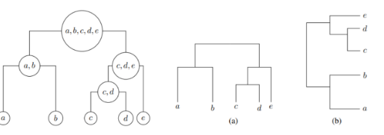
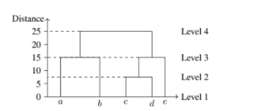

Slide 17
The hierarchical clustering technique has two approaches:
Agglomerative: Agglomerative is a bottom-up approach, in which the algorithm starts with taking all data points as single clusters and merging them until one cluster is left.
Divisive: Divisive algorithm is the reverse of the agglomerative algorithm as it is a top-down approach.
Why hierarchical clustering?
As we already have other clustering algorithms such as K-Means Clustering, then why we need hierarchical clustering? So, as we have seen in the K-means clustering that there are some challenges with this algorithm, which are a predetermined number of clusters, and it always tries to create the clusters of the same size. To solve these two challenges, we can opt for the hierarchical clustering algorithm because, in this algorithm, we don't need to have knowledge about the predefined number of clusters.

Slide 18
Agglomerative Hierarchical clustering
The agglomerative hierarchical clustering algorithm is a popular example of HCA. To group the datasets into clusters, it follows the bottom-up approach. It means, this algorithm considers each dataset as a single cluster at the beginning, and then start combining the closest pair of clusters together. It does this until all the clusters are merged into a single cluster that contains all the datasets.
This hierarchy of clusters is represented in the form of the dendrogram.
How the Agglomerative Hierarchical clustering Work?
The working of the AHC algorithm can be explained using the below steps:

Slide 19
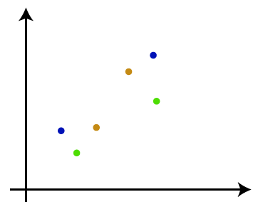
Step-1: Create each data point as a single cluster. Let's say there are N data points, so the number of clusters will also be N.
Step-2: Take two closest data points or clusters and merge them to form one cluster. So, there will now be N-1 clusters.

Slide 20
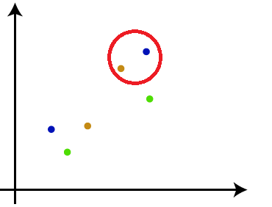
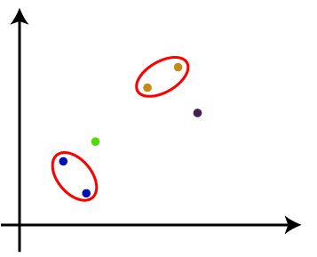
Step-3: Again, take the two closest clusters and merge them together to form one cluster. There will be N-2 clusters.

Slide 21
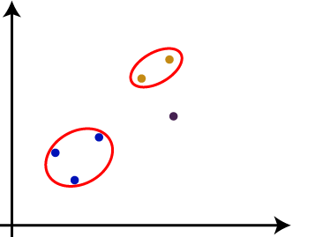
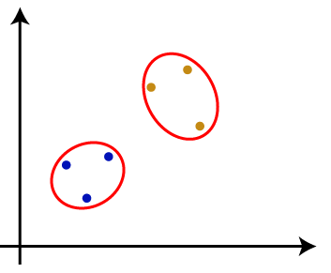
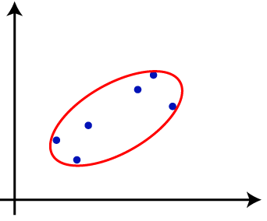
Step-4: Repeat Step 3 until only one cluster left. So, we will get the following clusters. Consider the below images:

Slide 22
Step-5: Once all the clusters are combined into one big cluster, develop the dendrogram to divide the clusters as per the problem

Slide 23
Supervised Learning After Clustering
Supervised learning following clustering involves utilizing the results of clustering to enhance the performance of supervised learning tasks, such as classification or regression. Here’s an overview of how this process typically works:
Clustering as a Preprocessing Step
Clustering is an unsupervised learning technique that groups similar data points based on their attributes. It helps to identify inherent structures in unlabeled data, which can be useful for subsequent supervised learning tasks. The primary goal of clustering is to form groups of similar instances, which can simplify the data and make it more manageable for classification or regression models.

Slide 24
Purpose of Clustering in Supervised Learning
Data Simplification: By grouping similar instances, clustering reduces the complexity of the dataset. This can lead to a more straightforward representation of the data, making it easier for supervised models to learn from it.
Feature Engineering: Clustering can create new features that represent the clusters. For example, each instance can be assigned a cluster label, which can then be used as an additional feature in supervised learning models.
Handling Imbalanced Data: In cases where certain classes are underrepresented, clustering can help identify similar instances within those classes, potentially improving the model's ability to learn from limited data.

Slide 25
Methodology
The typical approach involves the following steps
Clustering: Apply a clustering algorithm (e.g., K-means, hierarchical clustering) to the dataset to identify groups of similar instances.
Labeling Clusters: Once clusters are formed, they can be analyzed and labeled based on expert knowledge or predefined criteria. This labeling can provide insights into the characteristics of each group.
Training Supervised Models: Use the labeled clusters as features in a supervised learning model. This can involve using the cluster labels directly or creating new features that summarize the characteristics of each cluster.
Evaluation and Adjustment: After training the supervised model, evaluate its performance. Adjust the clustering method or the features used based on the results to optimize the learning process.

Slide 26
Advantages of This Approach
Reduced Labeling Costs: Clustering allows for the use of a larger amount of unlabeled data to identify patterns, which can be more cost-effective than labeling extensive datasets for supervised learning.
Improved Model Performance: By leveraging the structure identified through clustering, supervised learning models can achieve better accuracy and generalization, especially in complex datasets.
Flexibility: This method can be applied across various domains, including customer segmentation in marketing, anomaly detection in fraud detection, and more.
In summary, supervised learning after clustering serves as a powerful strategy to enhance model performance by leveraging the insights gained from clustering to inform and improve the supervised learning process

Slide 27
Dimensionality Reduction Techniques
Increasing the number of features will not always improve classification accuracy.
In practice, the inclusion of more features might actually lead to worse performance.
The number of training examples required increases exponentially with dimensionality d (i.e., k^{d}).
Therefore, we need to choose an optimum set of features to improve classification accuracy.

Slide 28
Dimensionality reduction is the process of reducing the number of variables under consideration by obtaining smaller set of principle variables.
There are many ways to achieve dimensionality reduction, but most of these techniques fall into one of two classes:
Feature Selection
Feature Extraction
Feature selection method selects k dimensions from set of d dimensions in the original dataset.

Slide 29
In feature selection, we try to find a subset of the original set of variables, or features, to get a smaller subset which can be used to model the problem.
K<N

Slide 30
Feature extraction: finds a set of new features through some mapping function f() from the existing features. The mapping f() could be linear or non-linear.
K<N

Slide 31
The various feature extraction methods used for dimensionality reduction:
Principal Component Analysis (PCA)
Linear Discriminant Analysis (LDA)
Generalized Discriminant Analysis (GDA)
Why dimensionality reduction is useful?
There are several reasons why we are interested in reducing dimensionality.
In most learning algorithms, the complexity depends on the number of input dimensions, d as well as on the size of the data sample, N, and for reduced memory and computation, we are interested in reducing the dimensionality of the problem. Decreasing d also decreases the complexity of the inference algorithm during testing.
When an input is decided to be unnecessary, we save the cost of extracting it.

Slide 32
Simpler models are more robust on small datasets. Simpler models have less variance, that is, they vary less depending on the particulars of a sample, including noise, outliers, and so forth.
When data can be explained with fewer features, we get a better idea about the process that underlies the data, which allows knowledge extraction.
When data can be represented in a few dimensions without loss of information, it can be plotted and analyzed visually for structure and outliers.

Slide 33
Principal component Analysis
PCA is an unsupervised learning algorithm that is used for the dimensionality reduction in machine learning.
This method is often used to reduce the dimensionality of large data sets, by transforming a large set of variables into a smaller one that still contains most of the information in the large set.
It is a statistical process that converts the observations of correlated features into a set of linearly uncorrelated features with the help of orthogonal transformation.

Slide 34
These new transformed features are called the Principal Components (PCs). Some properties of these principal components are given below:
The PC must be the linear combination of the original features.
These components are orthogonal, i.e., the correlation between a pair of variables is zero.
The importance of each component decreases when going to 1 to n, it means the First PC has the most importance, and n^{th} PC will have the least importance.

Slide 35
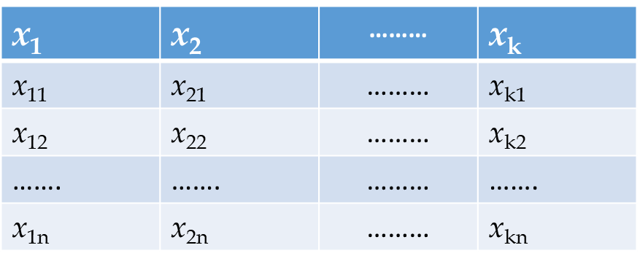
Working of PCA
Get the Dataset with k Features
Compute mean of the Dataset: Compute mean of each feature

Slide 36
3. Compute Correlation matrix of each feature pair

Slide 37
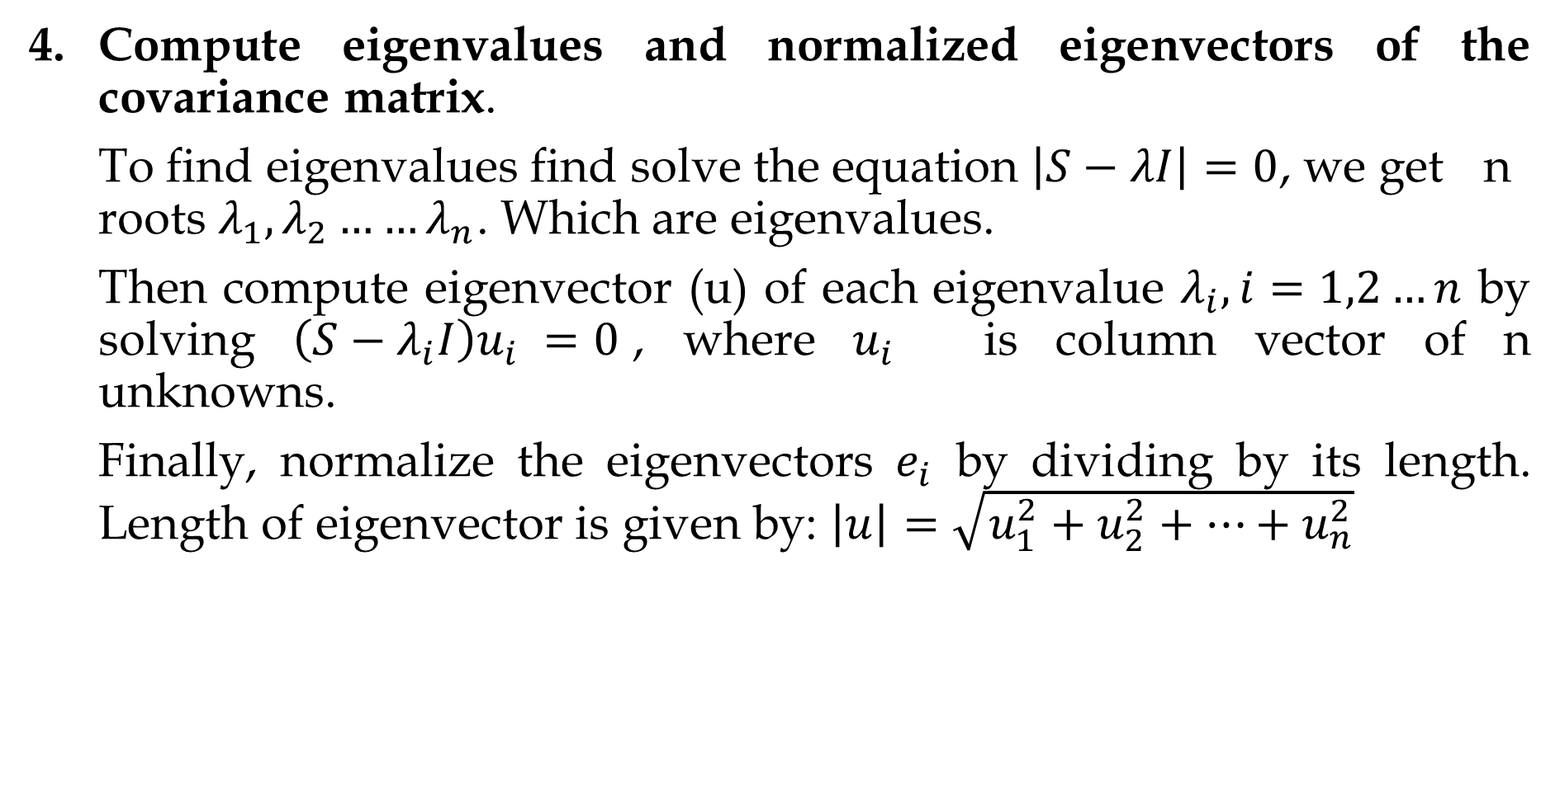
Compute eigenvalues and normalized eigenvectors of the covariance matrix.
To find eigenvalues find solve the equation $\left|S−λI\right|=0$, we get n roots $λ_{1},λ_{2}……λ_{n}$. Which are eigenvalues.
Then compute eigenvector (u) of each eigenvalue $λ_{i}, i=1,2…n$ by solving $\left(S−λ_{i}I\right)u_{i} =0$, where $u_{i}$ is column vector of n unknowns.
Finally, normalize the eigenvectors $e_{i}$ by dividing by its length. Length of eigenvector is given by: $\left|u\right|=\sqrt{u_{1}^{2}+u_{2}^{2}+…+u_{n}^{2}}$

Slide 38
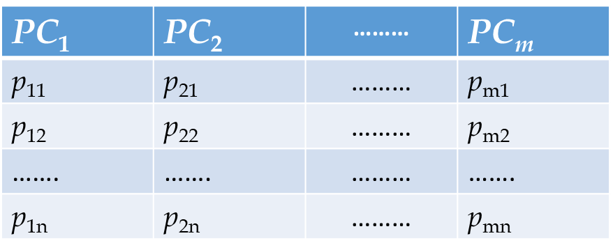
The normalized eigenvector corresponding to the largest eigenvalue is the first principle component.
Derive new dataset by using most important m principle components.

Slide 39
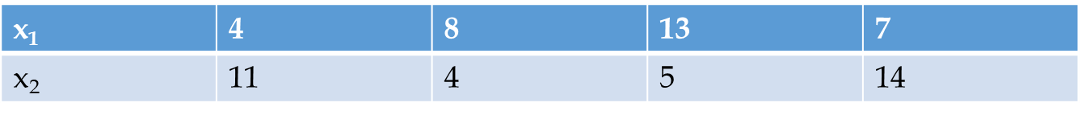
Example
Given the following 2-D dataset use PCA to determine principle components of the data and show 2-D transformed dataset.
Solution
No of Features (k)=2
Number of Samples(n)=4
Now, Compute mean of each feature
Compute covariance matrix

Slide 40
Compute eigen values

Slide 41
Solving this we get,
Compute eigen vectors
Solving this we get
Thus eigen vectors of

Slide 42
Solving this we get,
Thus, eigen vectors of

Slide 43
Normalize the eigen vectors
Finally, compute new data set using principle components

